Slide 1

NAME OF THE PROJECT:
A Power Point Presentation on: Flight Price Prediction
Submitted by:
A KISHORE KUMAR
Batch No.:
Internship_33

Slide 2
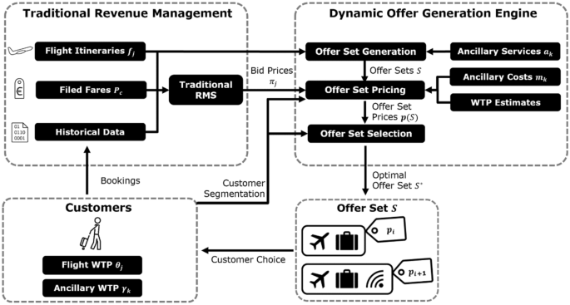
Introduction

Slide 3
Business Problem Framing:
The Airline Companies is considered as one of the most enlightened industries using complex methods and complex strategies to allocate airline prices in a dynamic fashion.
Customers are seeking to get the lowest price for their ticket, while airline companies are trying to keep their all-inclusive revenue as high as possible and boost their profit.
However, mismatches between available seats and passenger demand usually leads to either the customer paying more or the airlines company losing revenue.
Airlines companies are generally equipped with advanced tools and capabilities that enable them to control the pricing process.
Customers are also becoming more strategic with the development of various online tools to compare prices across various airline companies.
In addition, competition between airlines makes the task of determining optimal pricing is hard for everyone.
So, this project involves collection of data for flight fares with other features and building a model to predict fares of flights.

Slide 4
Mathematical / Analytical Modelling of the Problem:
First phase of problem modelling involves data scraping of flights from internet.
For that purpose, flight data is scrap from www.yatra.com for timeframe of 12 Jan 2023 to 23 Jan 2023.
Data is scraped for flights on route of New Delhi to Mumbai.
Data is scraped in three categories:
Economy class
Premium Economy class
Business class flights.
Next phase is data cleaning & pre-processing for building ML Model.
Our objective is to predict flight prices which can be resolve by use of regression-based algorithm.
Further Hyperparameter tuning performed to build more accurate model out of best model.

Slide 5
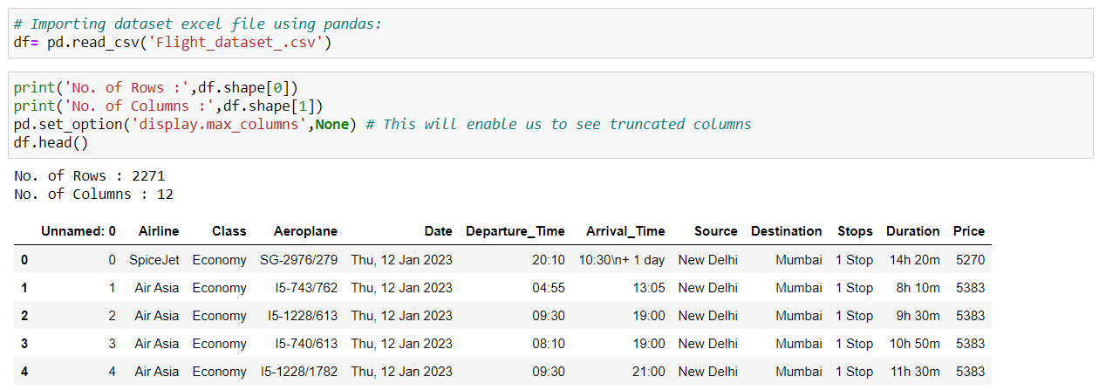
Data Sources and their formats:
Data is collected from www.yatra.com for timeframe of 12 Jan 2023 to 23 Jan 2023 using selenium and saved in CSV file.
Around 2500 flights details are collected for this project.
Training dataset contain 2271 rows and 12 columns.
Our Target variable is Price. We are going to predict flight prices using Various Regression Algorithms.

Slide 6
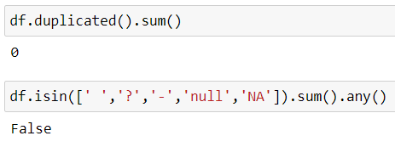
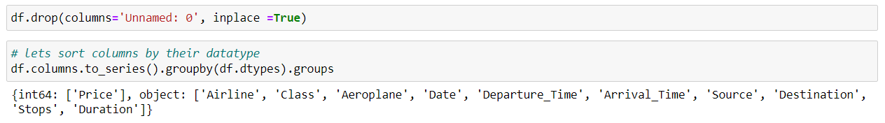
Some feature with date and time related columns are mention with object datatype, are to be converted into datetime datatype format along with going to perform some feature engineering of our interest.
Dataset does not contain duplicate data or any missing value.
Unnecessary column of index name as ‘Unnamed: 0’ is drop out. There are 12 features in dataset including target feature ‘Price’. The data types of different features are as shown below:

Slide 7
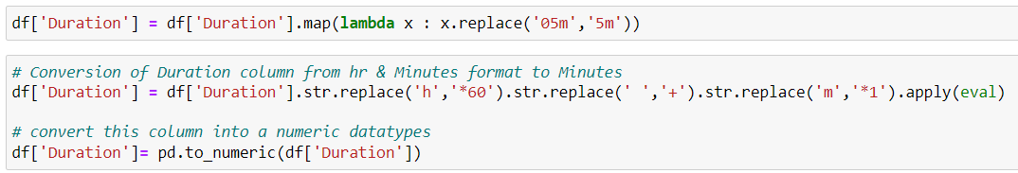

Data Preprocessing
1.Conversion of Duration column hr & Minutes format to Minutes
2.Create new column for day & date

Slide 8
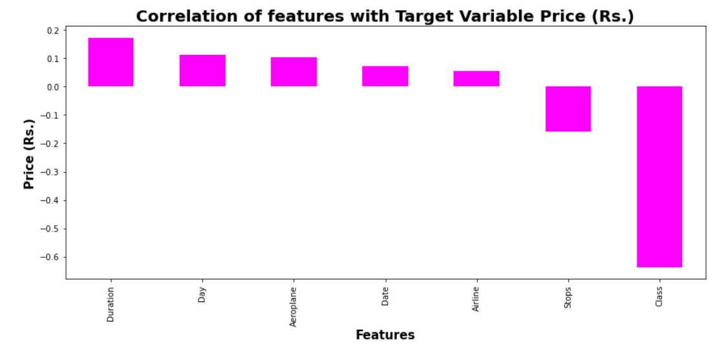
Correlation with Target Variable
Observation:
We can see that class feature is correlated for more than -0.6 with target variable Price.
Remaining feature are poorly correlated with target variable price.

Slide 9
Exploratory Data Analysis

Slide 10
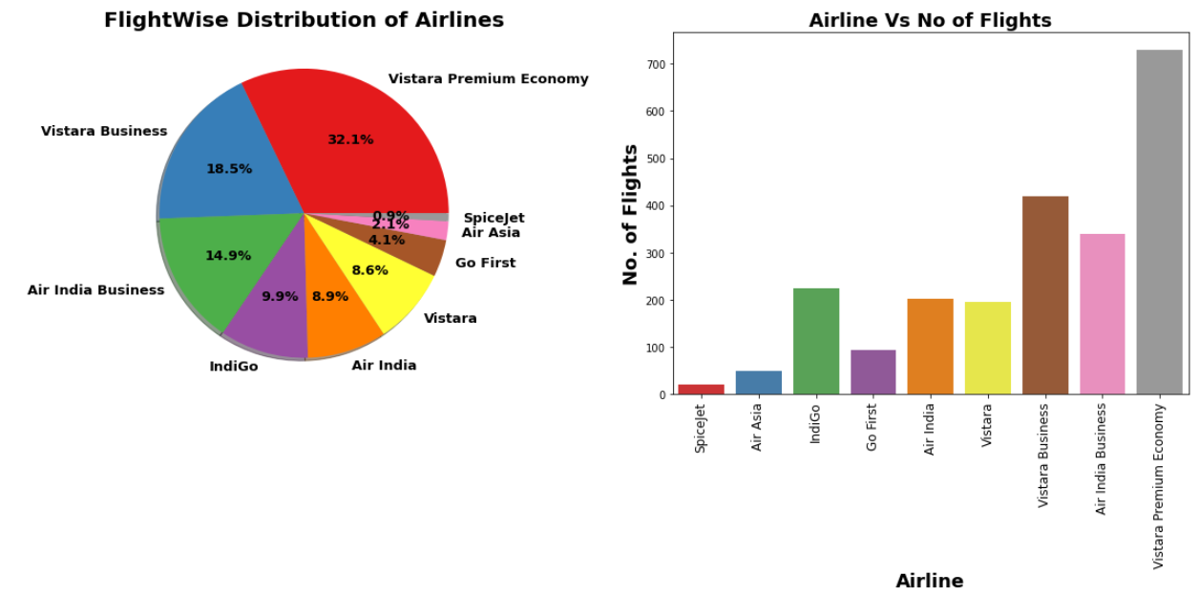
Flight-wise Distribution of Airlines
Observation:
We can see maximum number of flights run by Vistara Premium Economy while minimum Flights run by Spicejet.

Slide 11
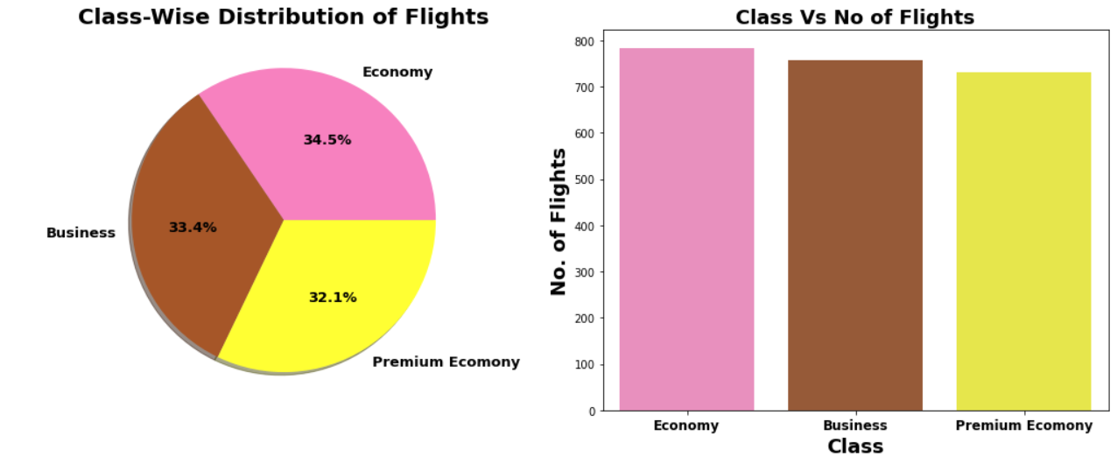
Class-wise Distribution of Flights
Observation:
To have a balanced dataset for price prediction all the three classes are being integrated into the dataset in equal proportions.

Slide 12
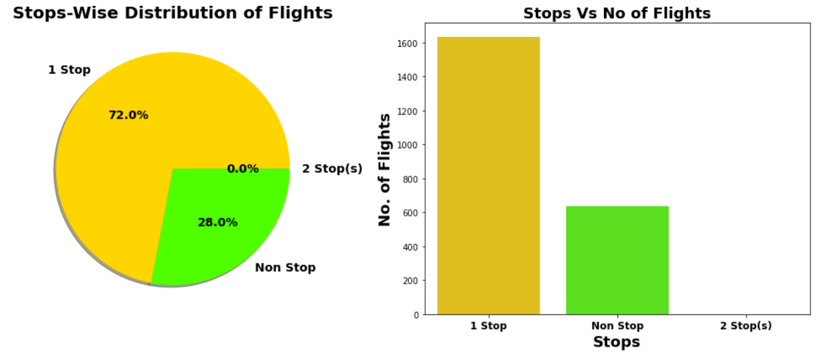
Stop-wise Distribution of Flights
Observation:
72% flights take single stop in there way from New Dehli to Mumbai.It is also possible that these flights may have high flight duration compare to Non-stop Flight.
28% of flights do not have any stop in their route.

Slide 13
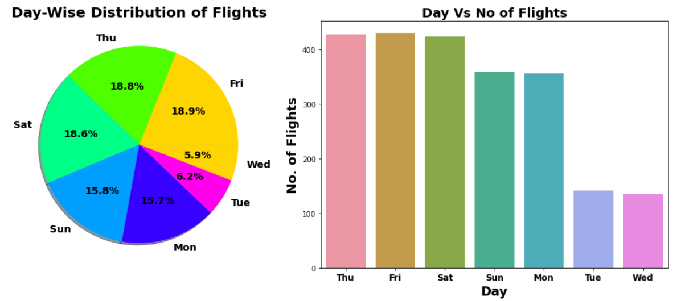
Day-wise Distribution of Flights
Observation:
On Friday Maximum flights run while on Wednesday minimum flights run.

Slide 14
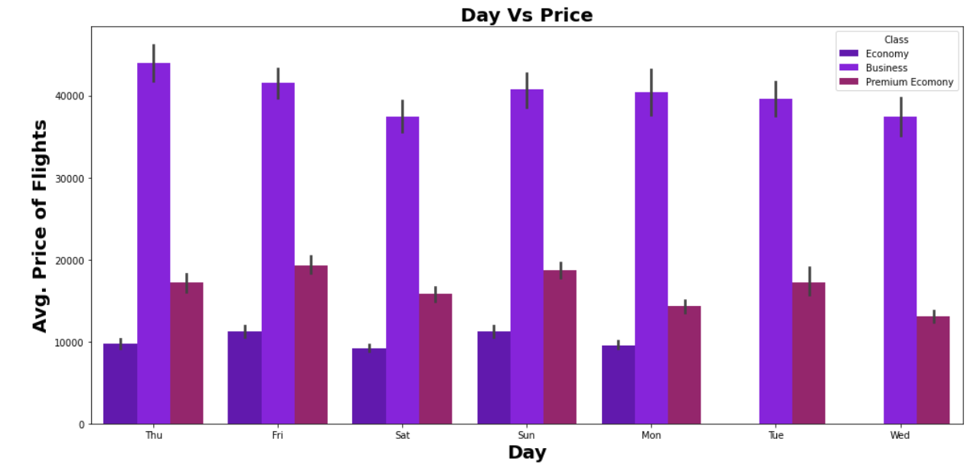
Day Vs Avg. Flight Price
Observation:
Maximum Avg. Fare for Business Flights is on Thursday while minimum Avg. Fare for Business flights on Saturday.
Maximum Avg. Fare for Economy Flights is on Sunday.
Maximum Avg. Fare for Premium Economy Flights is on Friday while minimum Avg. Fare for Premium Economy Flights on Wednesday.

Slide 15
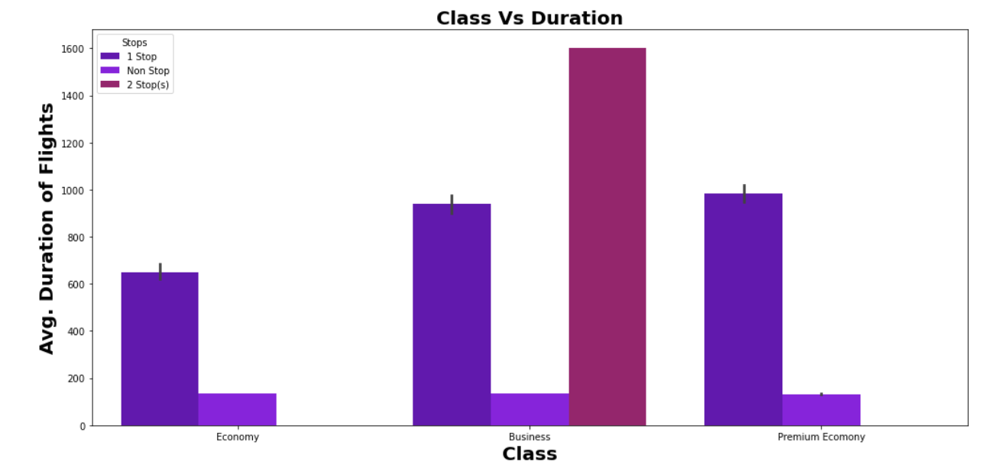
Class Vs Avg. Duration of Flights
Observation:
As Number of Stops increase the duration of flights increases.
As per Class of flight Maximum Avg. Duration of flight is for Business class.

Slide 16
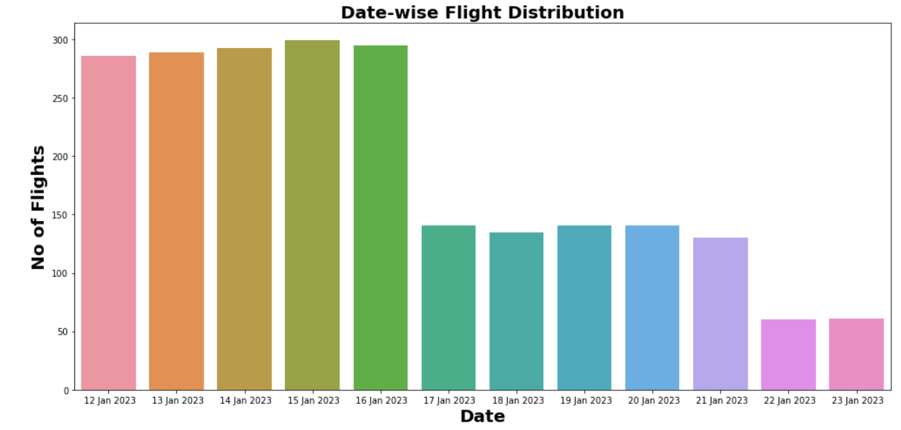
Date-wise Flight Distribution
Observation:
We can see those Maximum flights schedule on 15 Jan 2023 & Minimum flights schedule on 22 & 23 Jan 2023.

Slide 17
Machine learning MODEL BUILDING

Slide 18
Machine Learning Model Building
This problem can be solve using regression-based machine learning algorithm.
Methodology to Build Machine Learning Model:
Encoding Categorical data into Numerical data
Scaling data using Standard Scalar
Splitting data in training & test data using train_test_split from model_selection
Implementing various Regression Based Algorithm to build ML Model
Conducting 5 fold Cross validation
Hyper Parameter tuning of best Model
Saving Final Tuned Model using Joblib

Slide 19
REGRESSION ALGORITHMS IMPLEMENTATION
The different regression algorithm used in this project to build ML model are as below:
Linear Regression
Random Forest Regressor
Decision Tree Regressor
XGB Regressor
Extra Tree Regressor

Slide 20
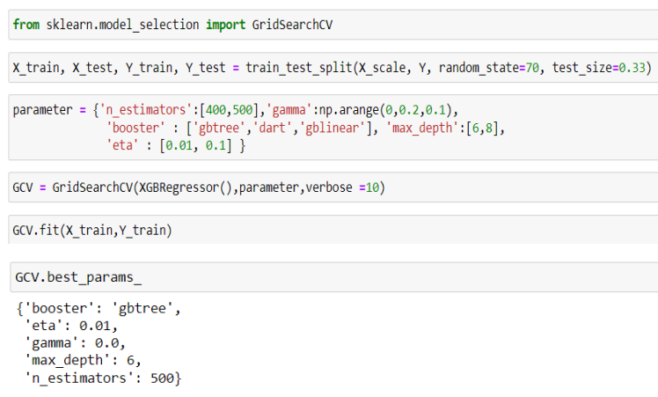
Hyper Parameter Tuning of Best Model
XGB Regressor gives maximum R2 score of 99.013 and maximum cross validation score.
Among all model we will select XGB Regressor as final model and hyper parameter tuning perform over this model to enhance its R2 Score.

Slide 21
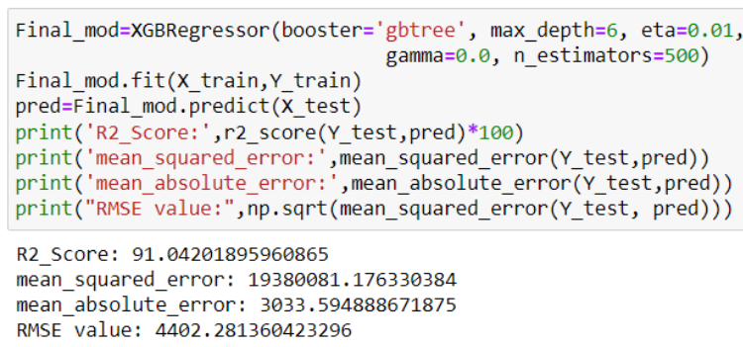
Final ML Hyper Parameter Tuned Model
There is Slight increase in R2-Score to 99.046% after hyper parameter tuning from previous R2-Score of 99.013%.

Slide 22
Final Evaluation Matrix
Algorithm | R2 Score | CV Score
Random Forest Regressor | 91.28 | 0.28
XGB Regressor | 91.42 | 0.19
Linear Regression | 62.22 | -2.54
Decision Tree Regressor | 84.49 | -0.009
Extra Tree Regressor | 84.31 | 0.078
XGB Hyper Parameter Tuned (Final Model) | 92.05 | 0.83
XGB Regressor giving us maximum R2 Score, so XGB Regressor is selected as best model.
After hyper parameter tuning Final Model is giving us R2 Score of 99.046% which is slightly improved compare to earlier R2 score of 99.013%.

Slide 23
Limitations of this work and
Scope for Future Work
In this study we focus on flights on route of New Delhi to Mumbai, more route can incorporate in this project to extend it beyond present investigation.
This investigation focuses on short timeframe (14 days prior flights take off) which can be extended variation over larger period.
Time series analysis can be performed over this model.

Slide 24
THANK YOU VERY MUCH !!!

